Slide 1
THE PROBLEM

Slide 2


Slide 3
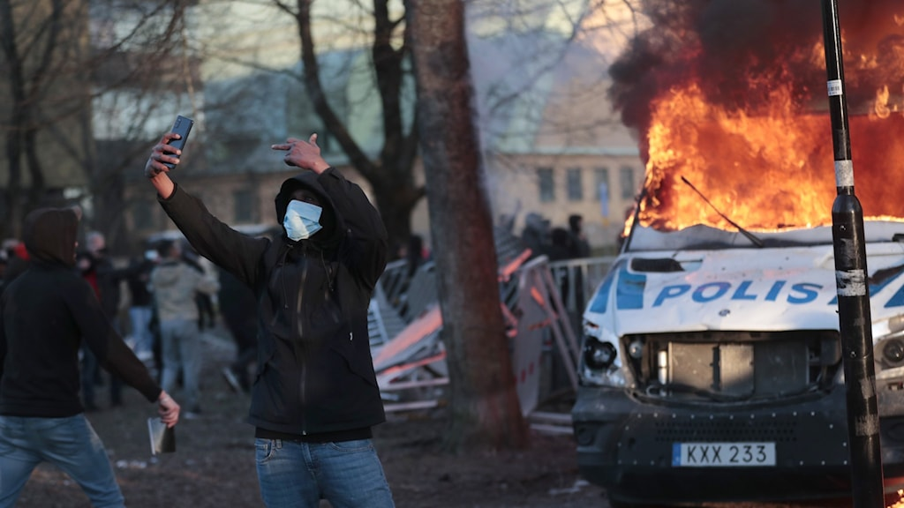
LOOK AT WHAT HAPPENS!

Slide 4

School; What’s the problem?
POLARISATION

Slide 5
How do we solve it?
J
E S U S
Jesuit
Educational
Society of
Universal
Schooling

Slide 6
How do we solve it?
J
E S U S
Jesuit
Educational
Society of
Universal
Schooling

Slide 7
Largest
J E S U S
Christmas
BUT WHY CHRISITANITY?
Easter
Don’t worship a cube

Slide 8
How do we know that it’s going to work?

Slide 9
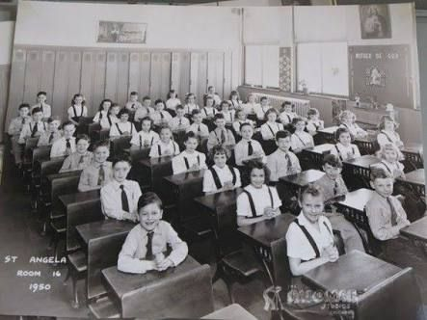
BEFORE
All following the seating plan
Happy!
Well dressed

Slide 10
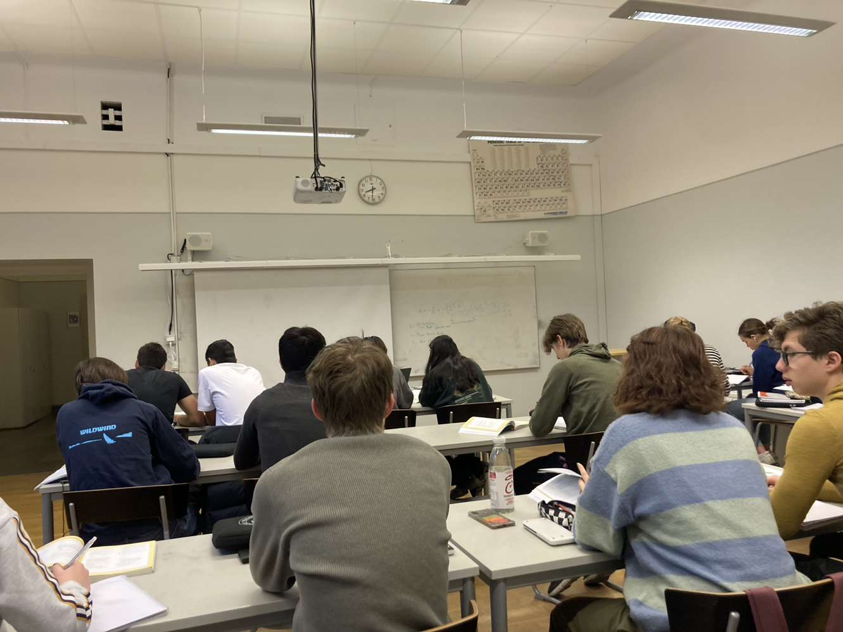
AFTER
~1/4 following the seating plan (if you’re lucky)
They can dress how they want?
Not a single happy person

Slide 11
Other Benefits
Will provide a moral foundation
No moral conflict
Much easier!

Slide 12






Slide 13
LET’S BECOME NON-POLAR
LET’S BECOME HOMOGENOUS

